Slide 1
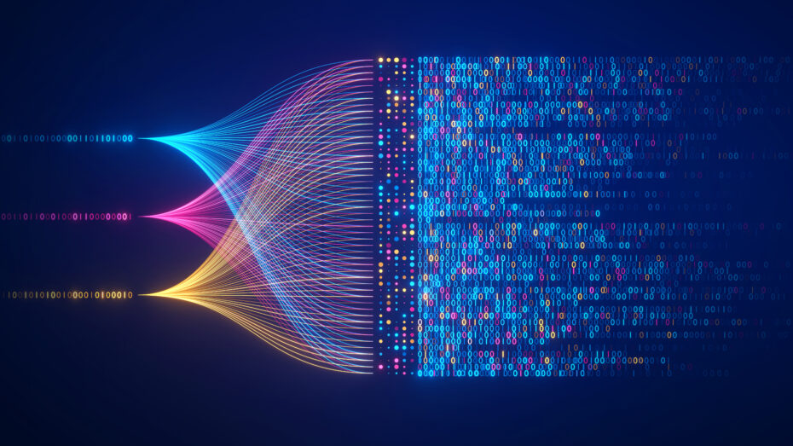
Data Science- Data Visualization

Slide 2
Data- What is it and Why it matters?
Data is information or facts about something.
It can be numbers, words, pictures, voices, even emotions!
Think of data as clues that help us understand patterns or answer questions.
Example: Collecting data on your classmates' favorite colors helps you see which color is the most popular.
Data is like a puzzle - each piece adds to the bigger picture!

Slide 3
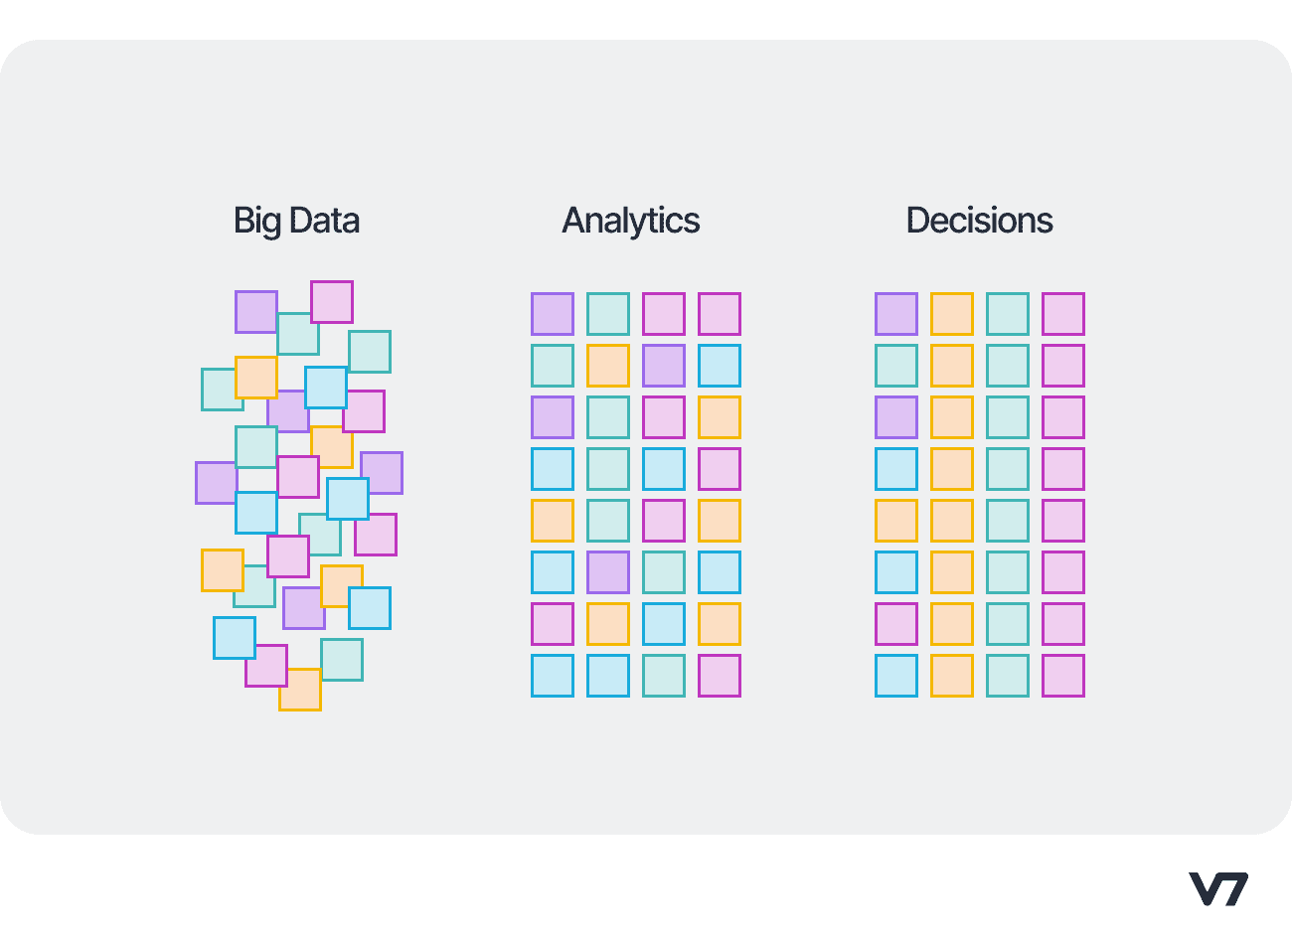
Data Scientists
1- Collect a lot of information (called "data") about things.
2- Use math and computers to find patterns or solve mysteries in the data.
3- Use the information that they got to make good decisions!

Slide 4
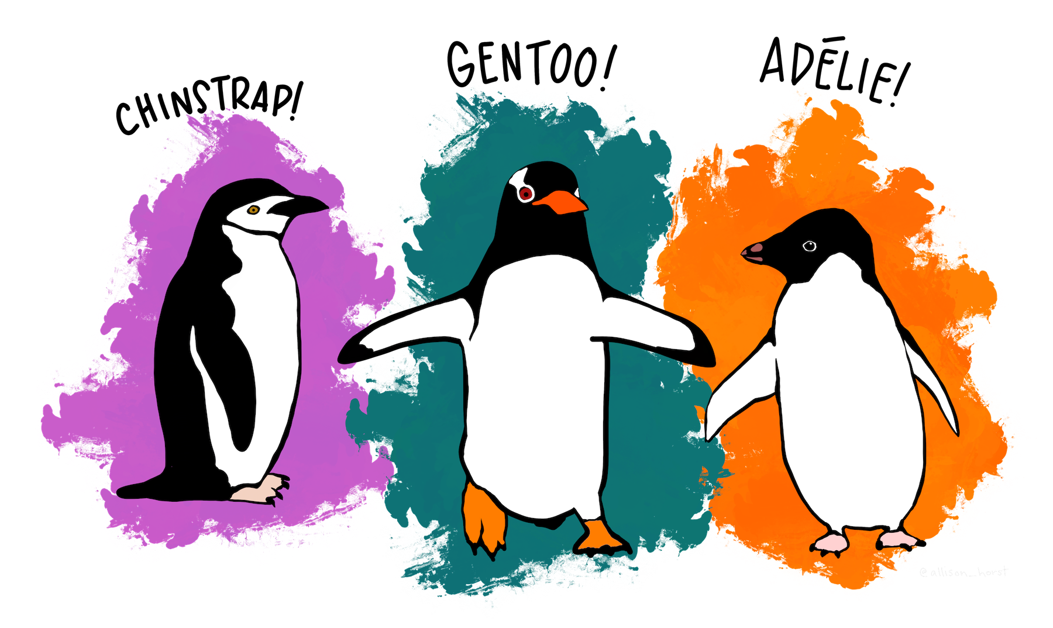
Penguins Activity
Artwork by @allison_horst

Slide 5
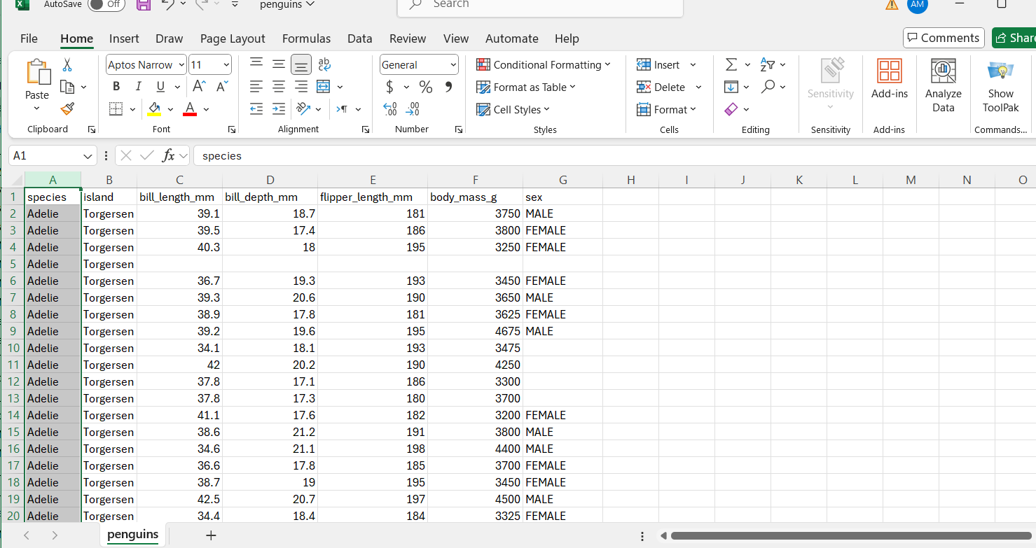

Slide 6
Data collected
Species:
Gentoo penguins are the fastest underwater swimmers of all penguins, reaching speeds up to 22 miles per hour!
Adélie penguins can walk up to 31 miles to find food and were named after the wife of a French explorer.
Chinstrap penguins get their name from the thin black line under their chin, making it look like they’re wearing tiny helmets!
Islands:
Biscoe Island is home to the most diverse penguin population in the dataset, hosting Gentoo, Adélie, and Chinstrap penguins!
Dream Island might sound magical, and it’s fitting because it’s mostly home to the fun-loving Adélie penguins.
Torgersen Island is small but special, known primarily as a nesting spot for Adélie penguins who thrive there in large colonies.

Slide 7
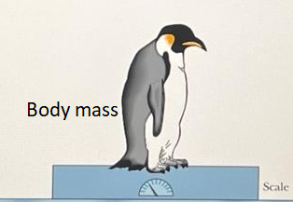
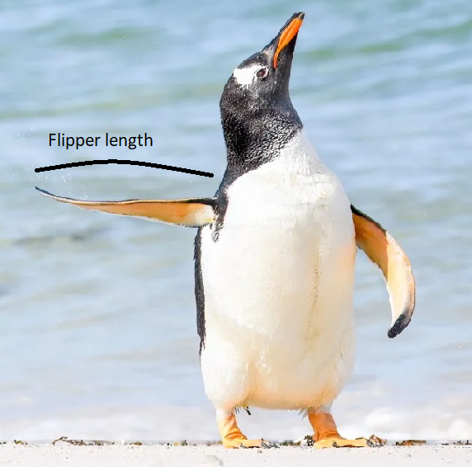
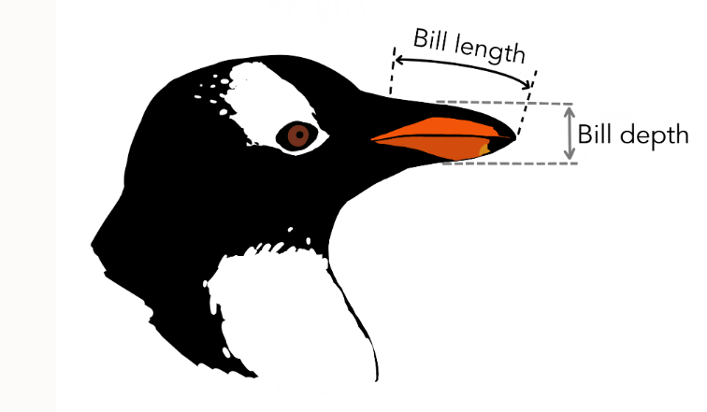
Image created by Twinkl
Artwork by @allison_horst
Talk To The Fin!" by Jennifer Hadley

Slide 8
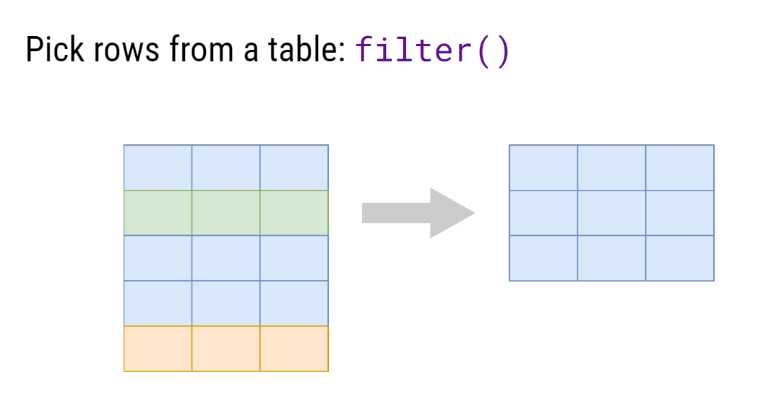

Slide 9
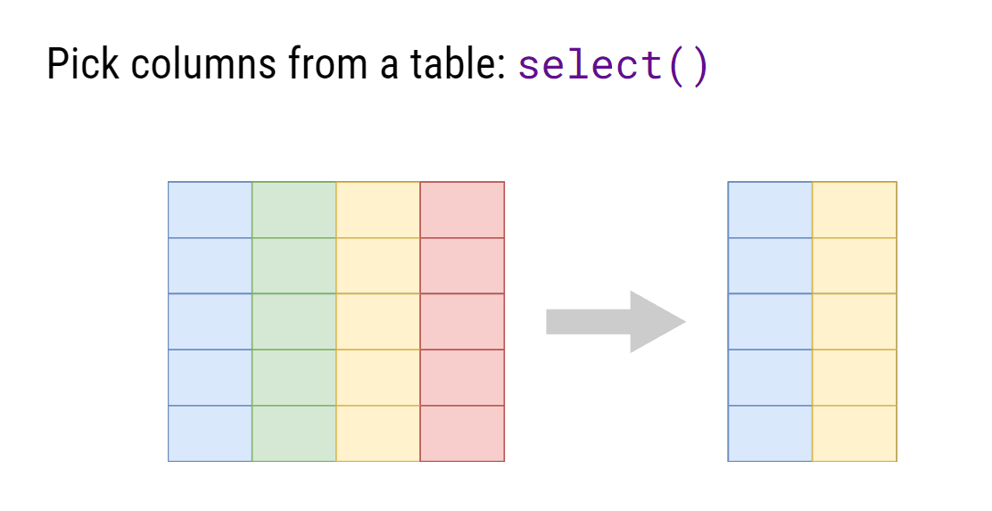

Slide 10
